Slide 1
Antiretrovirals for prevention in women of childbearing age: issues to consider
Landon Myer

Slide 2
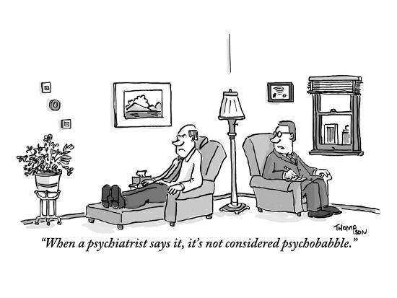
We all have “issues”

Slide 3
We all have “issues”
Focus on… antiretroviral risks and benefits: dolutegravir (DTG)
consider issues not beyond NTDs (or HIV)
Individuals vs populations
Intersection of two massive public health concerns
HIV treatment → mitigating risks of NTDs with DTG
Consequences of sex vs fertility intentions → unintended pregnancy

Slide 4
Risks
versus benefits
of DTG
in WHLIV

Slide 5
Risks
versus benefits
of DTG
in WHLIV
Sex & fertility
intentions in WLHIV

Slide 6
Risks
versus benefits
of DTG
in WHLIV

Slide 7
HIV treatment → risks vs benefits
All drugs have risks and benefits
Pregnancy unique: maternal & fetal considerations
HIV treatment has always balanced risks vs benefits
Change over time: new data; more experience; new perspectives
Alternatives matter in balancing

Slide 8
Tolerance
Resistance barrier
Viral suppression
Neural Tube Defects
Weight gain?
CVD risk?
Benefits
Risks
DTG

Slide 9
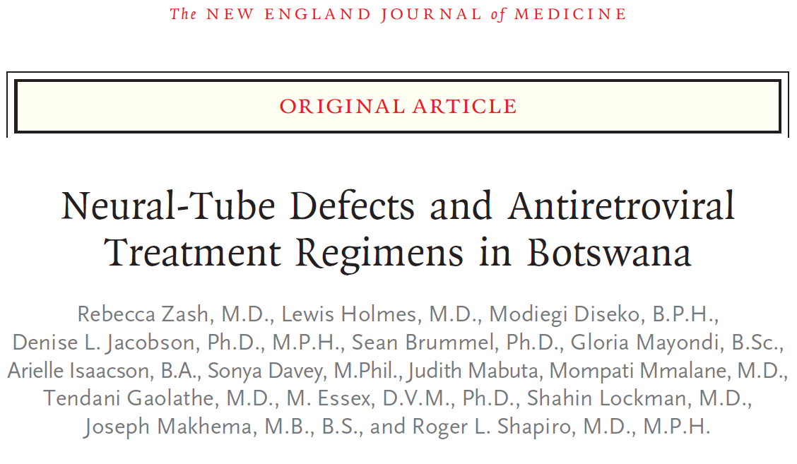
Tsepamo: Evolution of NTD Prevalence Over Time
May 2018 - March 2019
0.94
0.12
0.05
0.09
DTG preconception
May18 July Sept Nov Dec Mar19
N 426 1683
Non-DTG preconception
May18 July Sept Nov Mar19
11300 14792
EFV pre-conception
May18 July Sept Nov Mar19
5787 7959
HIV-uninfected
May18 July Sept Nov Mar19
66057 89372

Slide 10
Balancing risk vs benefits for individuals vs populations

Slide 11
Balancing risk vs benefits for individuals vs populations
Tolerance
Resistance barrier
Viral suppression
Benefits
Neural Tube Defects
Weight gain?
CVD risk?
DTG
Risks

Slide 12
Balancing risk vs benefits for individuals vs populations
Tolerance
Resistance barrier
Viral suppression
Neural Tube Defects
Weight gain?
CVD risk?
Benefits
Neural Tube Defects
Weight gain?
CVD risk?
Tolerance
Resistance barrier
Viral suppression
Risks
DTG
DTG
Risks
Benefits

Slide 14
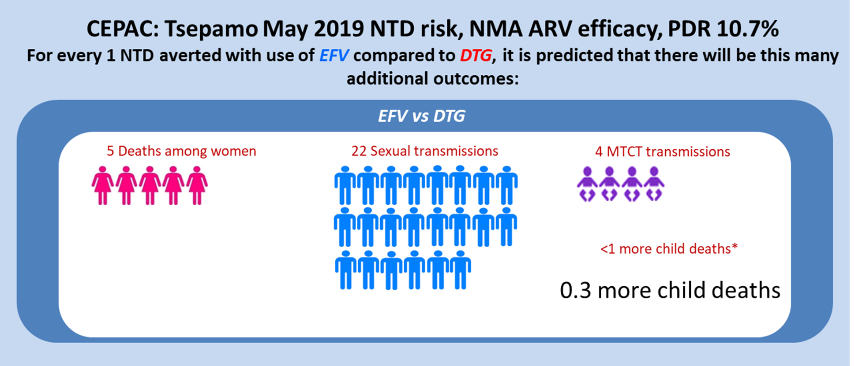
Risk vs benefits at a population level
Source: C Dugdale

Slide 15
Shifting the risk-benefit balance
Could folate supplementation help shift risk-benefit balance?
Folate supplementation routine in pregnancy, but usually started too late to influence neural tube closure
Population folate supplementation (bread, flour) used to prevent NTDs in many settings

Slide 16
Study | Food Folate Fortification | #NTD/# PC Exposures
Tsepamo 2019 (IAS 2019) | No | 5/1683
CDC-MOH Botswana (IAS 2019) | No | 1/152
Sibiude, France (CROI 2019) | No | 0/41
Chouchana, France (JAIDS 2019) | No | 0/49
Thorne, EPPICC confidential | No | Confidential
Weissmann, Germany (Glasgow 2018) | No | 0/3
Kowalska, eastern Europe (Glasgow 2018) | No | 0/24
Bornhede, Sweden (Eur J ID 2018) | No | 0/14
Orrell, multicountry ARIA (Lancet HIV 2017) | No | 0/1
APR Jan 2019 (IAS 2019) | International registry (most) | 1/247 (0.40%)
Brazil case-control (IAS 2019) | Yes | 0/384
PHACS, US confidential | Yes | Confidential
Advance, S Africa (CROI 2018) | Yes | 0/16
Money, Canada (BJOG 2019) | Yes | 0/69
Grayhack, US (AIDS 2018) | Yes | 0/28
No folate food fortification, DTG NTD prevalence
6 NTD / 2,031 = weighted estimate 0.36% (0.10-0.62)
No folate fortification, NTD pooled prevalence general population: 0.09-0.1%
DTG vs general population: ~3.6 to 4-fold increase
With folate food fortification, DTG NTD prevalence
1 NTD / 901 = weighted estimate 0.12% (0.0-0.34)
Folate fortification, NTD pooled prevalence general population: 0.06%
DTG vs general population: ~2-fold increase
Source: L Mofenson

Slide 17
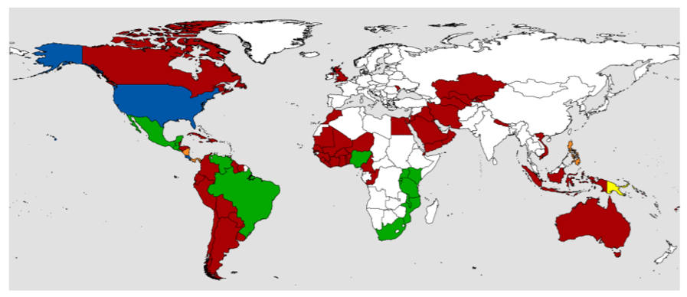
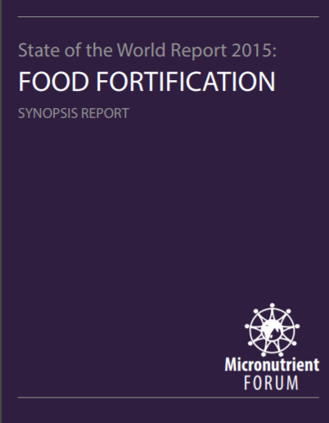
Countries with Folate Food Fortification
40-66% decrease
in NTD
in countries with
folate food
fortification
(Keats EF. Am J Clin Nutr. 2019
Kancherla V. Birth Defects Res. 2018
Crider KS. BJM. 2014
Das JK. Syst Rev. 2013)

Slide 18
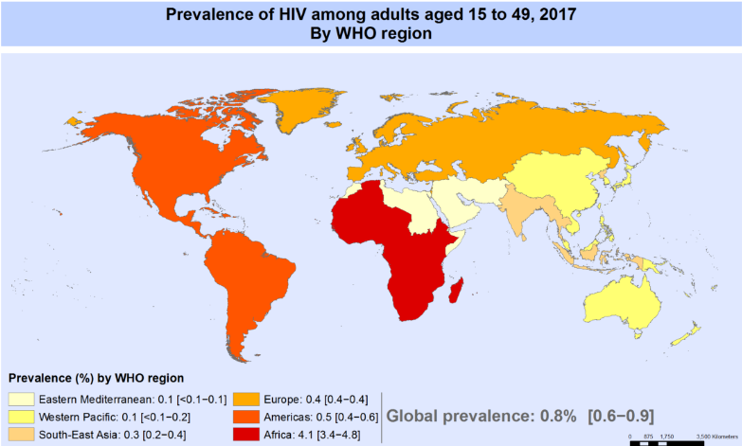
Countries with Folate Food Fortification
Many of the countries with the heaviest burden of HIV have no folate food fortification policies

Slide 19
Countries with Folate Food Fortification
WHO recommends folate fortification of food as a public health strategy to reduce the risk of NTD
The potential protective effect of folate in women receiving DTG and wish to become pregnant not established, but folate food fortification is important in improving pregnancy outcomes
2016: WHO: fortification of maize flour and corn meal with vitamins and minerals. www.who.int/reproductivehealth/publications/maternal_perinatall_health/a91272
2018: WHO: fortification of rice with vitamins and minerals as a public health strategy.
apps.who.int/iris/bitstream/handle/10665/272535/9789241550291-eng.ped?ua=1
Many of the countries with the heaviest burden of HIV have no folate food fortification policies

Slide 20
Sex & fertility
intentions in WLHIV

Slide 21
Fertility intentions
Widespread recognition of reproductive rights of HIV+ individuals
Fertility intentions in WLHIV (& MLHIV)
Increased attention to supporting fertility intentions
Safe reproduction services

Slide 22
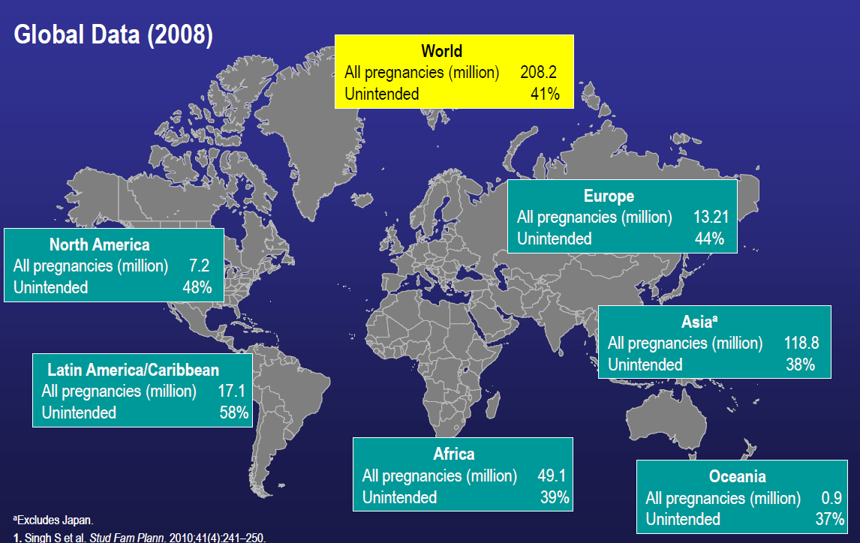
Unintended pregnancies
Source: FIGO
Globally, 33-50% of all pregnancies are not intended at the time of conception

Slide 23
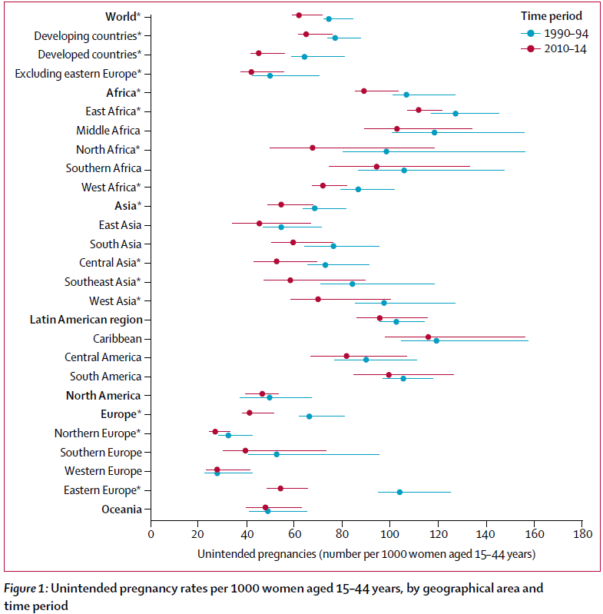
Unintended pregnancies
Rates of unintended pregnancy are highest where HIV is most prevalent
Bearak Lancet Glob Health 2018

Slide 24
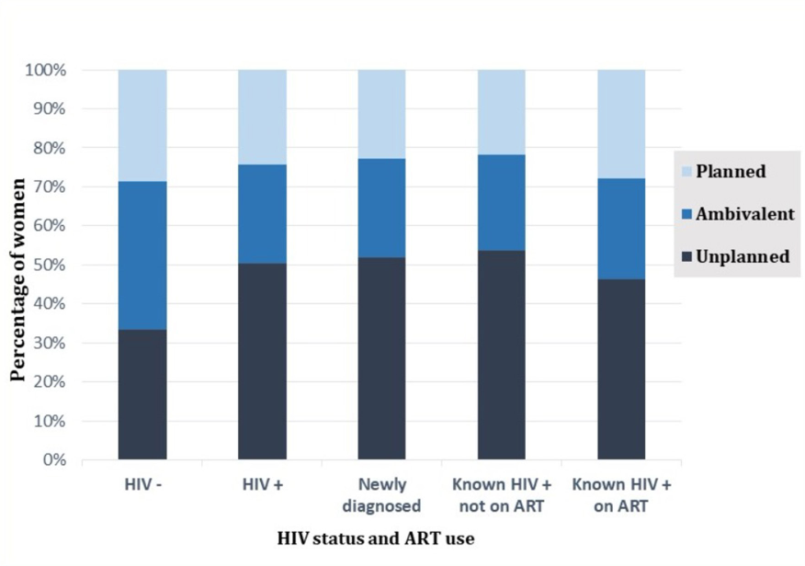
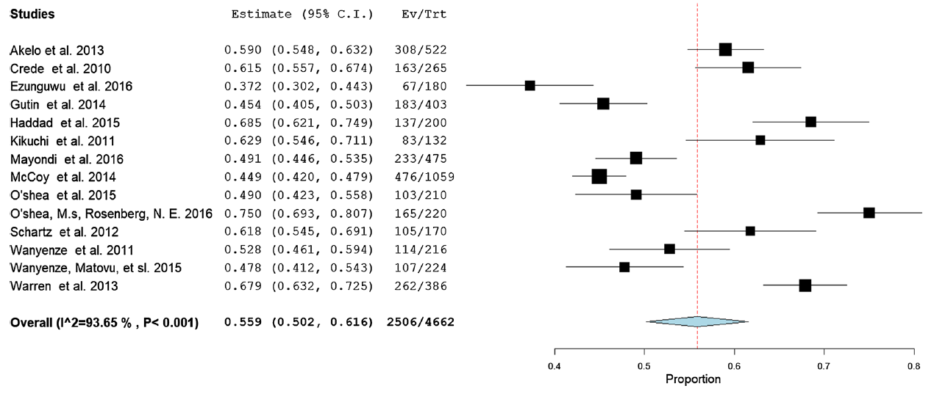
Unintended pregnancy more common in WLHIV in Africa
Meta-analysis: ~55% in WLHIV
versus ~40% from DHS in SSA
Borne out in direct comparisons
Feyissa AIDS Behav 2019
Iyun BMJ Open 2018

Slide 25
Implications of unintended pregnancies
Unintended pregnancy associated with negative maternal and child health outcomes on average
Poorer outcomes of unintended pregnancy in younger women
Maternal psychosocial health, quality of life
Parenting time
Increased maternal risk taking (causal?)
Increased prematurity, low birth weight
Shorter breastfeeding duration
Gipson Stud Fam Plann 2008
Schwarz Contraception 2008
Family Health International 2012
Chandra Vital Health Stat 2005
Mohllajee Obstet Gyneco. 2007
Kost Fam Plann Perspect 1998

Slide 26
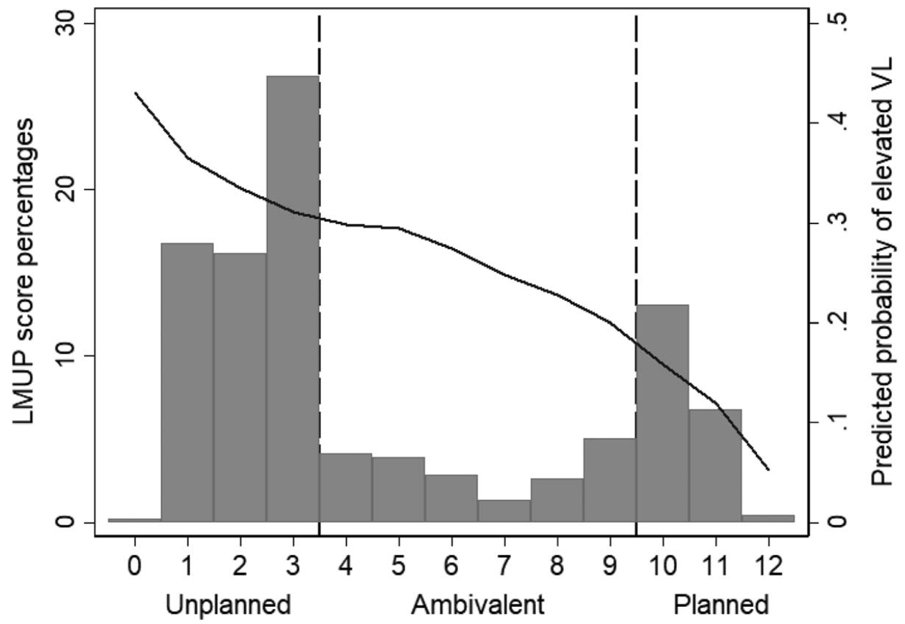
Unintended pregnancies in women using ART
WLHIV with unintended pregnancy have worse ART outcomes on average
Independent of mental health, socio-demographics, IPV, poverty, stigma, social support
Causal mechanism unclear
Brittain AIDS 2019

Slide 27
What are the implications for DTG and NTDs?
CEPAC: May 2019 Tsepamo
ARV efficacy per NMA, PDR 10.7% For every 1000 South African WCP with HIV starting ART, per year, compared with EFV (average over 5 yrs):
DTG
DTG-C
DTG
1 more NTDs
0 more NTDs#
CEPAC model: reducing unintended pregnancies in women using DTG effectively eliminates NTD concerns
Needs high coverage of effective methods
Reducing unintended pregnancies as goal of integrating contraceptive & family planning services into ART
<1 fewer child deaths*
Fewer child deaths with DTG vs EFV
0 more child deaths#
3 more women alive
1 more women alive
13 more men without HIV
5 more men without HIV
3 fewer MTC transmissions
0 fewer MTC transmissions*
3 more children alive and HIV-free
0 more children alive and HIV-free*
*n<0.5; #n=0; numbers ≥0.5 rounded up
Dugdale / WHO 2019

Slide 28
Conclusions: How to balance these issues
Tolerance
Resistance barrier
Viral suppression
Neural Tube Defects
Weight gain?
CVD risk?
Benefits
Neural Tube Defects
Weight gain?
CVD risk?
Tolerance
Resistance barrier
Viral suppression
Risks
DTG
DTG
Risks
Benefits

Slide 29
Conclusions: How to balance these issues
Neural Tube Defects
Weight gain?
CVD risk?
Neither issue is about DTG (or HIV)
→ broader public health engagement beyond vertical programmes
Tolerance
Resistance barrier
Viral suppression
Risks
DTG
Benefits
Increasing food folate fortification & reducing unintended pregnancies will help shift the risk-benefit balance

Slide 30
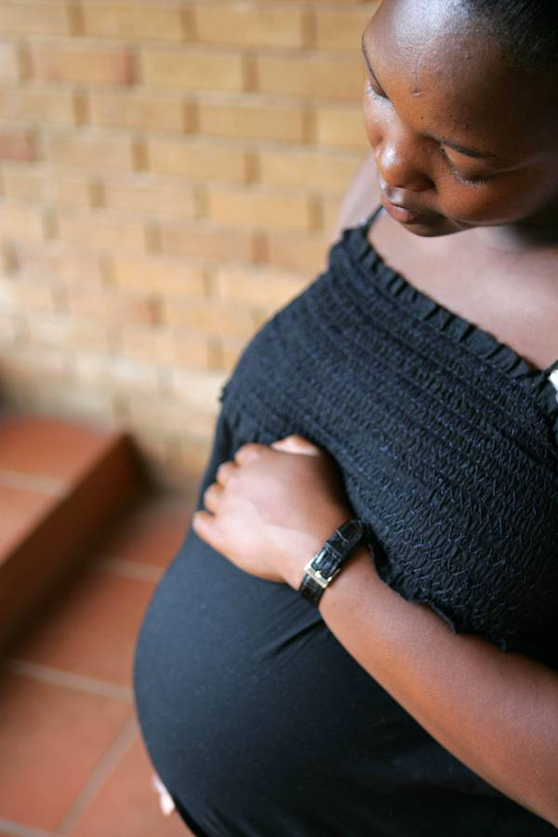
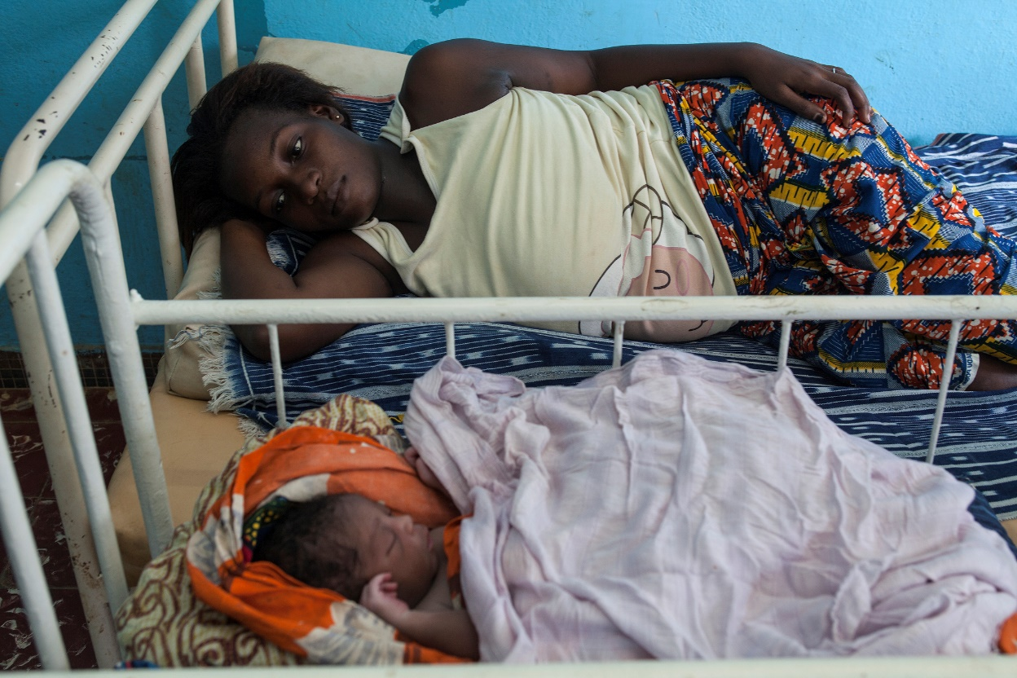
Acknowledgements
Lynne Mofenson
Mary-Ann Davies
Martina Penazzato
Mary Mahy
Thokozile Malaba
Jennifer Jao
Lena Serghides
Tamsin Phillips
Sinead Delany-Moretlwe
Caitlin Dugdale
Elaine Abrams
Andrea Ciaranello

